Slide 1



Modeling of the strategic raw material supply for the European hydrogen target 2030
Marzia Sesini¹, Sebastian Zwickl-Bernhard², Max Münchmeyer², Benjamin F. Hobbs³
¹Robert Schuman Centre for Advanced Studies, European University Institute, Via dei Roccettini 9, I-50014 San Domenico di Fiesole, Italy
²Energy Economics Group (EEG), Technische Universität Wien, Gusshausstrasse 25-29/E370-3, 1040 Wien, Austria
³Department of Environmental Health & Engineering, The Johns Hopkins University, Ames Hall 313,3400 North Charles Street, Baltimore, MD 21218, USA
Internal Meeting / 22 November 2023 / Online
Contact: zwickl@eeg.tuwien.ac.at

Slide 2
Topics based on the review by Ben and Marzia
Nonlinear term in the objective function of the upper-level problem
Representation of the capacity constraint (“function f”)
Demand elasticity
Arbitrage between markets
Storage

Slide 3
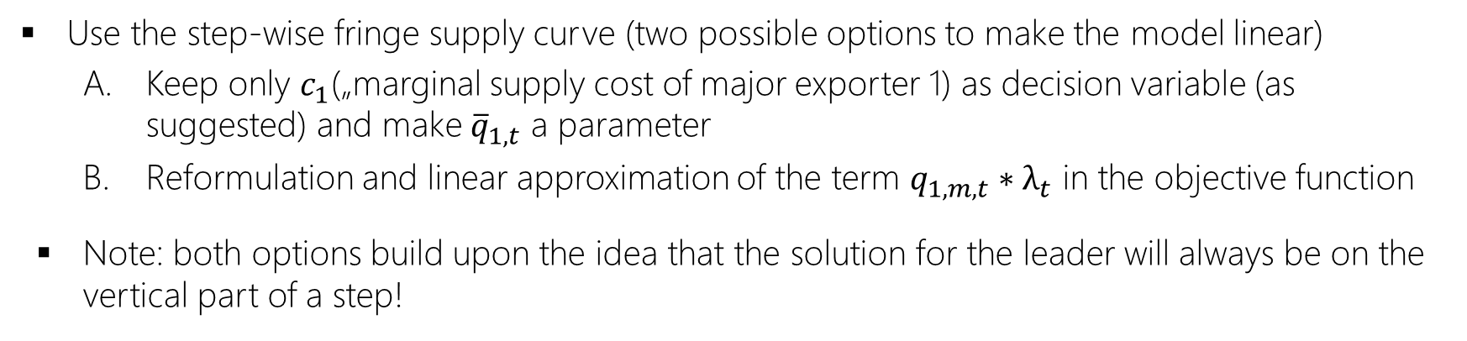
1. Nonlinear term in the objective function (1/4)
The solution difficulty arises from having q_i,t_bar and c_i both as decision variables? But maybe only one instrument is needed? I.e., given the step-wise fringe supply curve that results from the subproblem (Section 3.1), the optimal (revenue maximizing) solution for the leader will always be on the vertical part of a step (never in the middle of a horizontal part, unless the q_i_bar is binding). So actually, ony c_i is needed as an upper level variable, and not q_i,t_bar (omit the latter, and just inserrt q_i,t_bar = q_i_bar as the upper bound. The best solution for the leader will be where c_i cuts a vertical face of the fringe suppply, unless i's output = q_i_bar.
Use the step-wise fringe supply curve (two possible options to make the model linear)
Keep only $c_{1}$(„marginal supply cost of major exporter 1) as decision variable (as suggested) and make ${\overline{q}}_{1,t}$ a parameter
Reformulation and linear approximation of the term $q_{1,m,t}∗λ_{t}$ in the objective function
Note: both options build upon the idea that the solution for the leader will always be on the vertical part of a step!

Slide 4
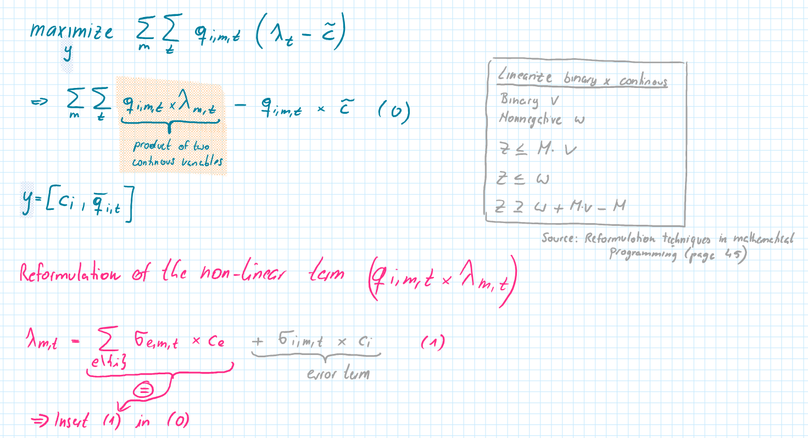
1. Nonlinear term in the objective function (2/4)

Slide 5
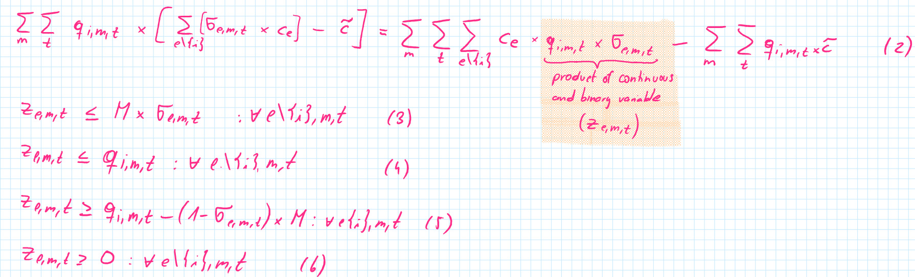
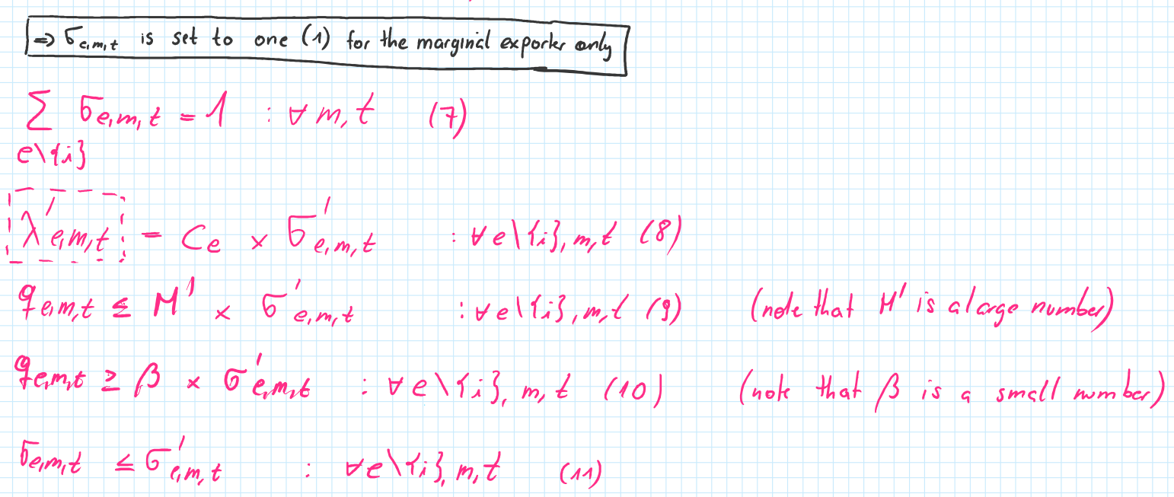
1. Nonlinear term in the objective function (3/4)

Slide 6
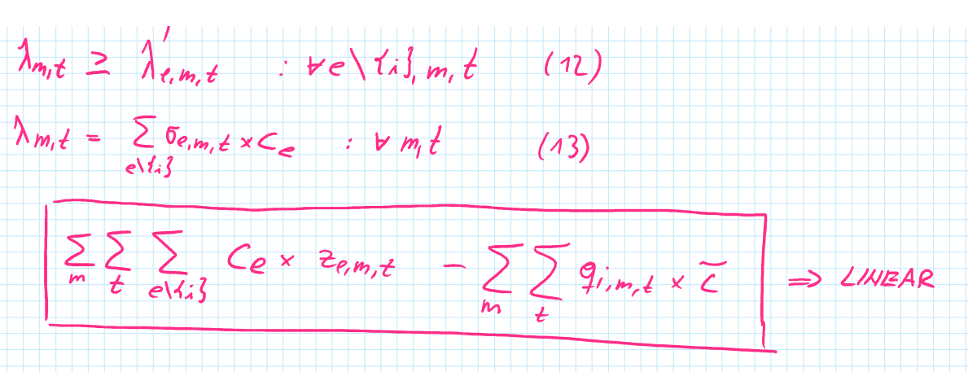
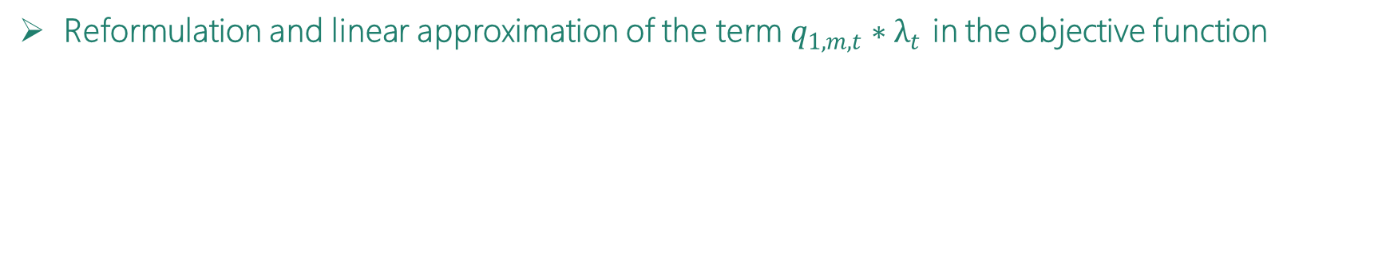
1. Nonlinear term in the objective function (3/3)
Reformulation and linear approximation of the term $q_{1,m,t}∗λ_{t}$ in the objective function

Slide 7
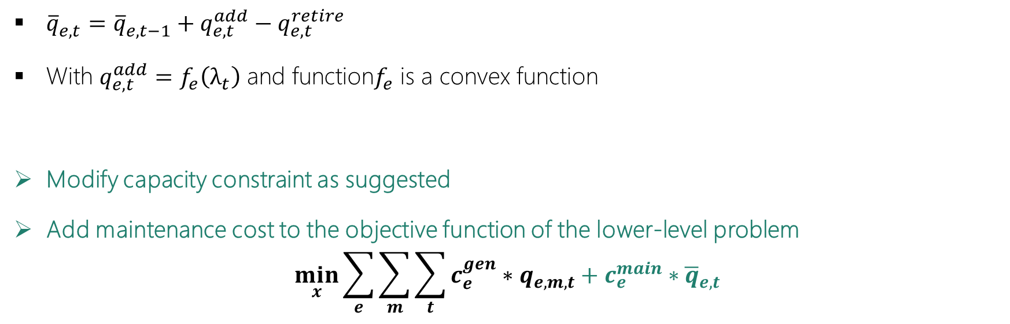
2. Representation of the capacity constraint (“function f”)
Would a better representation of the capacity constraint for e be q_e,t_bar = q_e,t-1_bar + qADDED_e,t_bar - qRETIRE_e,t_bar with qADD_e,t_bar = some convex function of lambda_t-1? (add more capacity if price is higher?) And have some maintenance cost associated with q_e,t_bar so there is an incentive to retire capacity if prices are low?
${\overline{q}}_{e,t}^{}={\overline{q}}_{e,t−1}^{}+q_{e,t}^{add}−q_{e,t}^{retire}$
With $q_{e,t}^{add}=f_{e}\left(λ_{t}\right)$ and function$f_{e}$ is a convex function
Modify capacity constraint as suggested
Add maintenance cost to the objective function of the lower-level problem
$$\min_{x}{\sum_{e}{\sum_{m}{\sum_{t}{c_{e}^{gen}∗q_{e,m,t}+c_{e}^{main}∗{\overline{q}}_{e,t}}}}}$$

Slide 8
3. Demand elasticity
Demand could be elastic (depend on lamda)…include in objective function with a quadratic concave benefit (or piecewise linear)
To be discussed
Penalty for relaxing demand
Cap the market clearing price? < oo ; slope of demand curve ; explore how solution changes

Slide 9
4. Arbitrage between markets
Arbitrage: will be easier if you have a separate arbitrage player with just ($q_{M1,M2,t}^{ARB}$) being a single unrestricted variable, and being subtracted from the market clearing for M1 and added to the market clearing for M2. Don’t need one for each player. This will make the KKTs much simpler.
Agree that this approach (separate arbitrage player) would make the model clearer and certainly easier
However, due to the diversification restriction, it is necessary in my opinion that the arbitrage is carried out separately for each exporter
Otherwise, the 65% limit of the supply share per exporter cannot be guaranteed
Maintain current formulation of the model regarding individual arbitrage per exporter (direct and in directed purchases, problem in actual markets, real world, optimistic world ☺)

Slide 10
5. Storage
Could add storage (one per country, or just one storage player…this would result in some arbitrage over time, unless there’s a limit to the amount that can be put in storage
Undisputedly an important point in the topic of critical raw material supply (keyword stockpiling)
However, there are several arguments against explicitly including storage in our analysis
5-year time steps in the model (i.e., would require significant storage capacity, which is uncertain)
Modified capacity constraint (as suggested by Ben & Marzia) takes into account delay in production capacity change
Storage are not explicitly included in the model but mentioned in “future work” ➔ duration and magnitude ; major exporter influences the (optimal) storage capacity; based on price variation identify the importance of stockpiling ; share of the annual demand (year before)

Slide 11
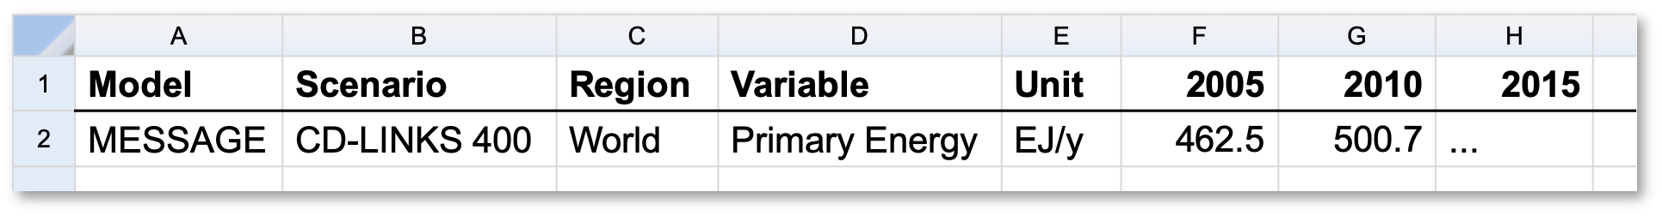
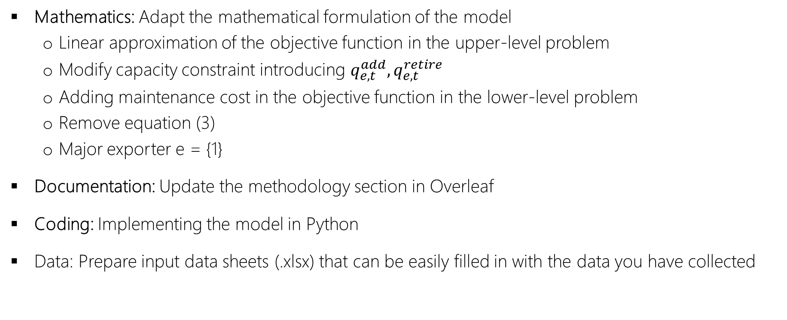
Next steps for the model
Mathematics: Adapt the mathematical formulation of the model
Linear approximation of the objective function in the upper-level problem
Modify capacity constraint introducing $q_{e,t}^{add}, q_{e,t}^{retire}$
Adding maintenance cost in the objective function in the lower-level problem
Remove equation (3)
Major exporter e = {1}
Documentation: Update the methodology section in Overleaf
Coding: Implementing the model in Python
Data: Prepare input data sheets (.xlsx) that can be easily filled in with the data you have collected
Collect all the materials (model, presentation slides, etc.) in a GitHub repository
IAMC template

